Slide 1

Web and Cloud Security
Department of Economic Informatics and Cybernetics
Bucharest University of Economic Studies
Microsoft Azure
Liviu-Adrian Cotfas, PhD.
liviu.cotfas@ase.ro

Slide 2

About me
https://ro.linkedin.com/in/cotfasliviu

Slide 3
Azure App Service

Slide 4
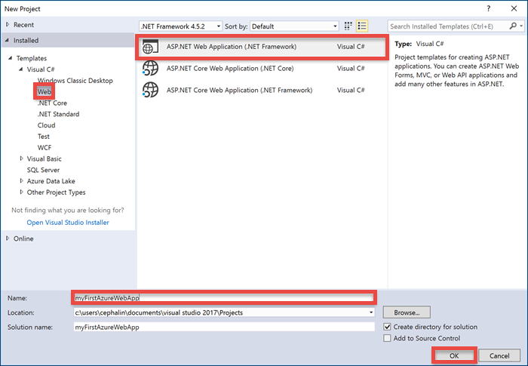
Azure App Service
Further reading: https://docs.microsoft.com/en-us/azure/app-service-web/app-service-web-get-started-dotnet

Slide 5
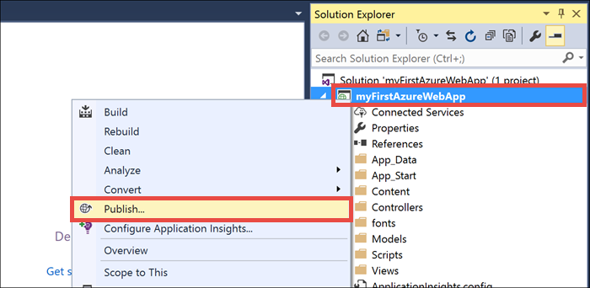
Azure App Service

Slide 6
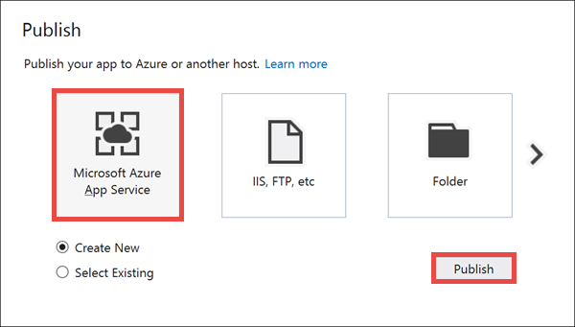
Azure App Service

Slide 7
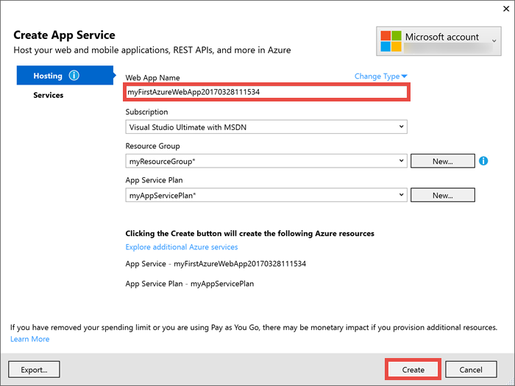
Azure App Service

Slide 8
SQL Sever

Slide 9
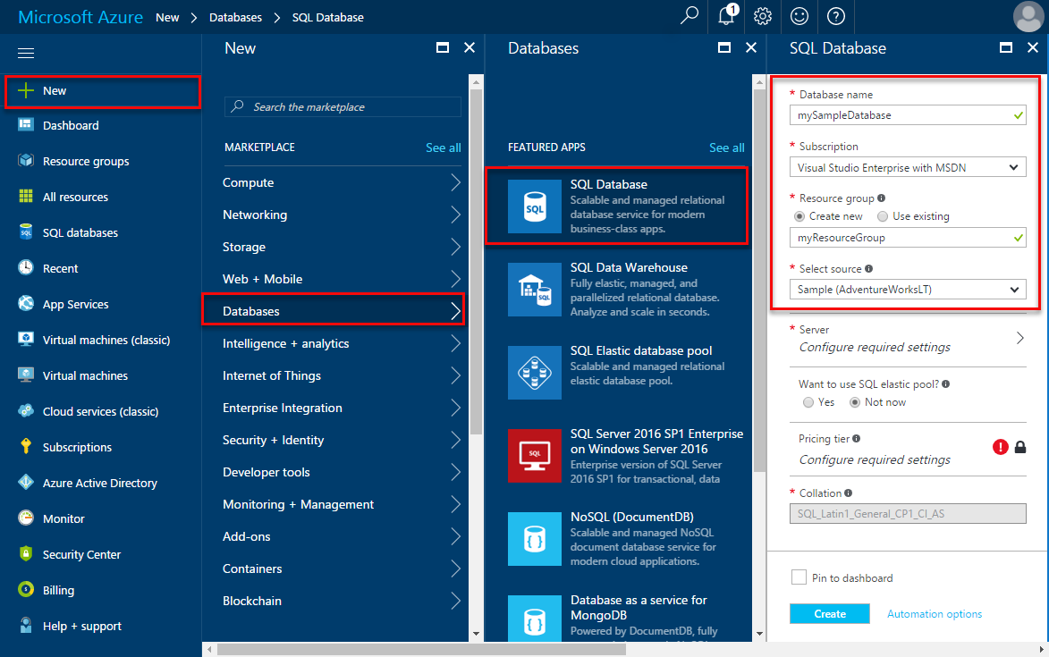
Create an Azure SQL database in the Azure portal
Further reading: https://docs.microsoft.com/en-us/azure/sql-database/sql-database-get-started-portal

Slide 10
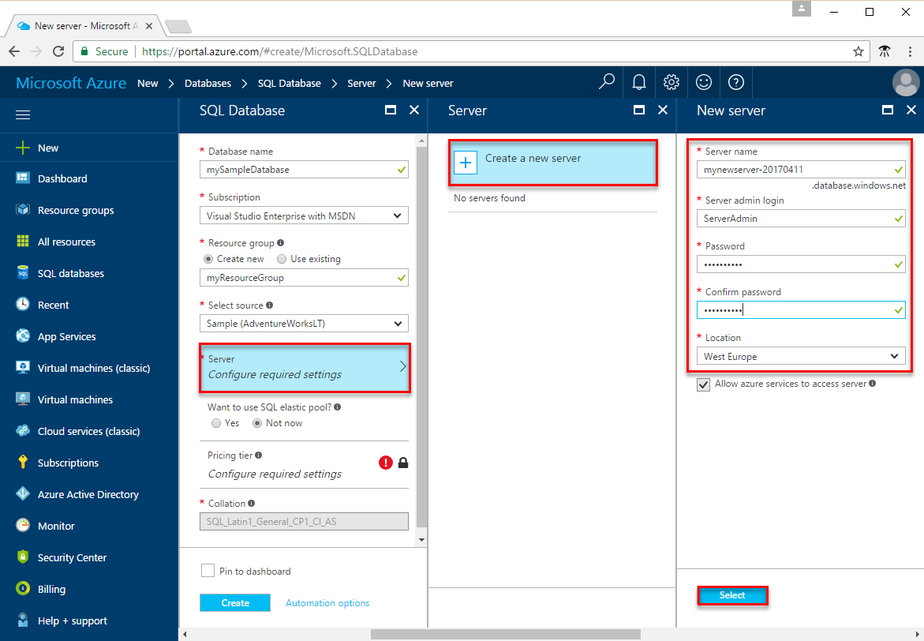
Create an Azure SQL database in the Azure portal

Slide 11
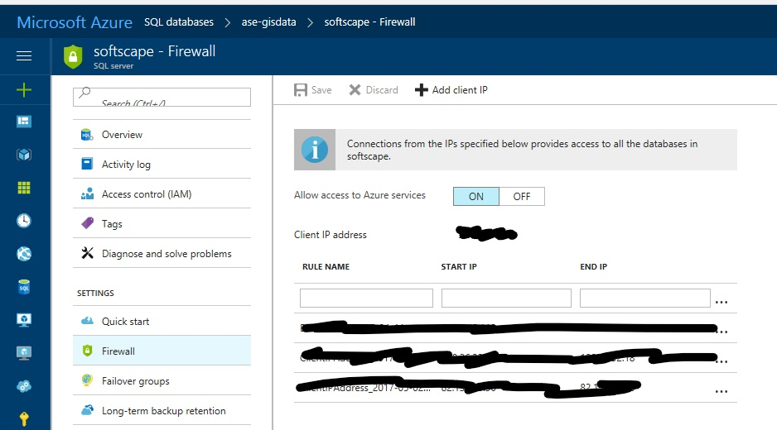
Create an Azure SQL database in the Azure portal
Create a server-level firewall rule

Slide 12
Application Insights

Slide 13
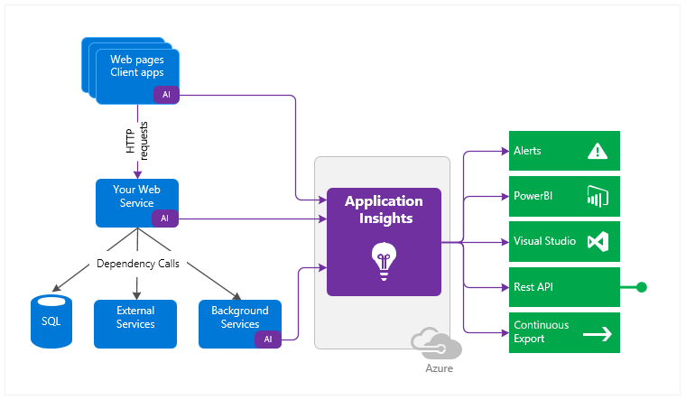
Application Insights
Further reading: What is Azure Application Insights? - Azure Monitor | Microsoft Docs

Slide 14
Thank you!

